Slide 1
Data Types

Slide 2
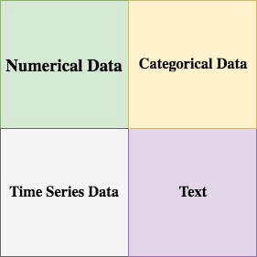
Most data can be categorized into 4 basic types from a Machine Learning perspective: numerical data, categorical data, time-series data, and text.

Slide 3
Numerical Data
Numerical data is any data where data points are exact numbers. Statisticians also might call numerical data, quantitative data. This data has meaning as a measurement such as house prices or as a count, such as a number of residential properties in Los Angeles or how many houses sold in the past year.
Numerical data can be characterized by continuous or discrete data. Continuous data can assume any value within a range whereas discrete data has distinct values.

Slide 4
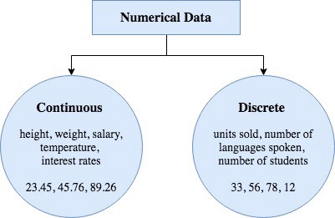

Slide 5
Categorical Data
Categorical data represents characteristics, such as a hockey player’s position, team, hometown. Categorical data can take numerical values. For example, maybe we would use 1 for the colour red and 2 for blue. But these numbers don’t have a mathematical meaning. That is, we can’t add them together or take the average.
In the context of super classification, categorical data would be the class label. This would also be something like if a person is a man or woman, or property is residential or commercial.

Slide 6
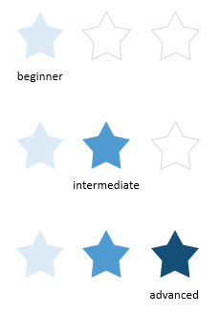

Slide 7
Time Series Data
Time series data is a sequence of numbers collected at regular intervals over some period of time. It is very important, especially in particular fields like finance. Time series data has a temporal value attached to it, so this would be something like a date or a timestamp that you can look for trends in time.

Slide 8
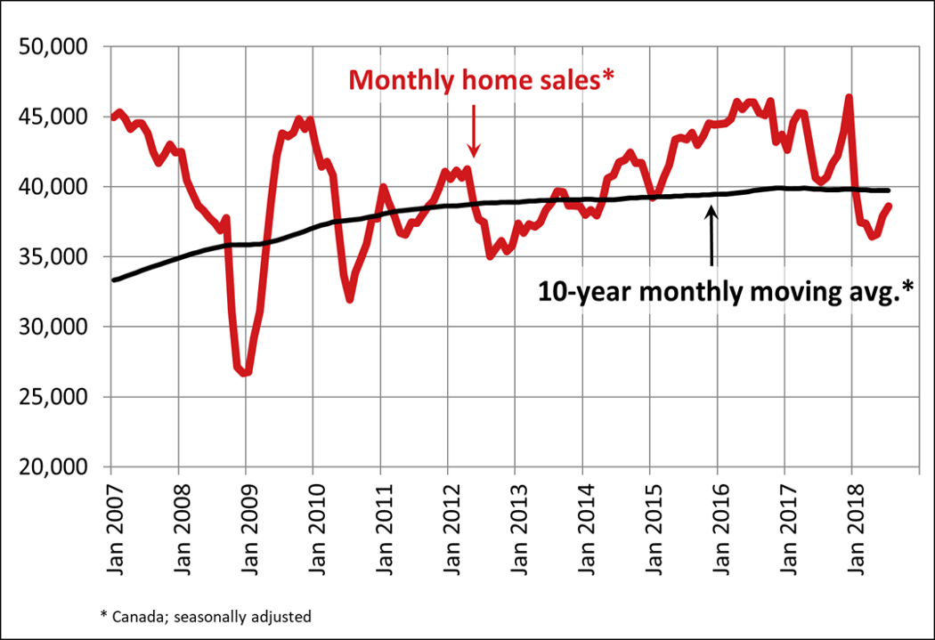

Slide 9

Text
Text data is basically just words. A lot of the time the first thing that you do with text is you turn it into numbers using some interesting functions like the bag of words formulation.

Slide 10
Plotting data with Python :
As mentioned above, Python has several good packages to plot the data and among them Matplotlib is the most prominent one. Seaborn is also a great package which offers a lot more appealing plot and even it uses matplotlib as its base layer.

